Slide 1
Google Ads Campaign Performance Analysis
By Ahsan Mubarak

Slide 2
Business Context and Objective
Context: In digital marketing, companies spend a lot of money on ads to reach the right audience. Google Ads is one of the most used platforms because it can reach millions of people fast. But not every impression or click gives value. Metrics like CTR, CR, and ROI are important to know if the campaign is really working. Understanding how users move from impressions to clicks, leads, and finally conversions is key to optimize ad spend.
Objective: The aim of this analysis is to evaluate the performance of Google Ads campaigns based on CTR, CR, ROI, and funnel stages. By doing this, we can identify which part of the funnel has the biggest drop, and how to improve efficiency.

Slide 3
Dataset Overview
Dataset: Google Ads Campaign Data
Source: Kaggle - Google Ads Campaign Data
This dataset contains simulated Google Ads campaign data promoting data analytics courses and services.
This dataset includes:
Clicks
Impression
Coasts
Leads
Conversions
Conversions Rate

Slide 4

Overall CTR and CR
Insight
Overall CTR 3.19%, Based on the Google Ads benchmark CTR of 3.19%, this campaign is slightly above the general standard, but still needs evaluation and optimization to perform better in the next run.
Overall CR 4.94%, it’s close to 5%, which is already good for a website/e-commerce. This shows the campaign has good audience segmentation.

Slide 5
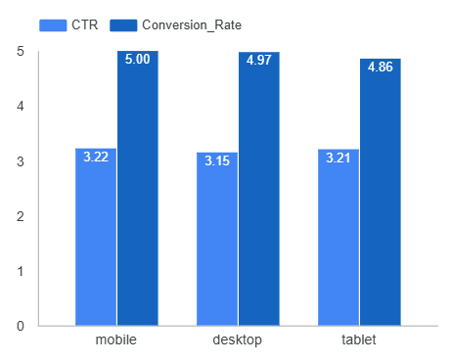
CR and CTR per Device
Insight
CTR is around 3%
CR is around 4-5%
Mobile is the highest CR and CTR device
Ad quality and landing page performance are consistent and well-optimized across all devices.

Slide 6
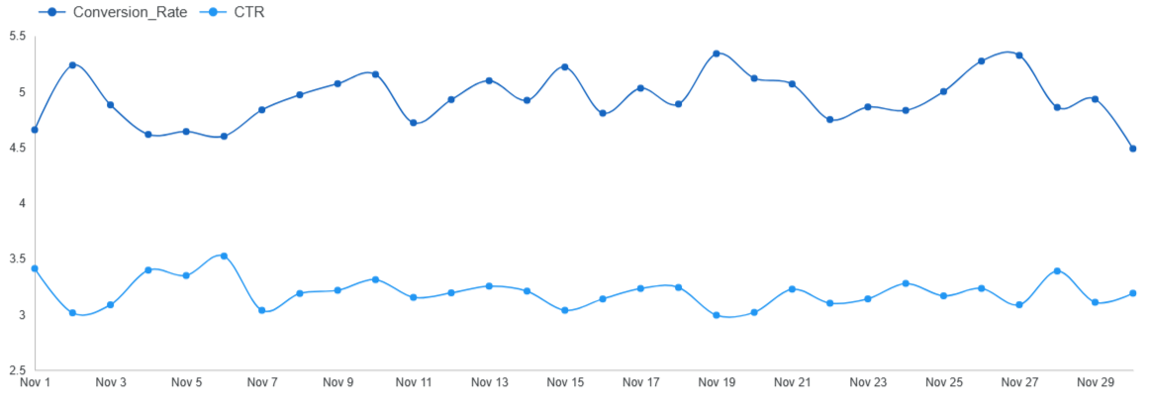
CR and CTR Overtime
Insight
CR stays stable around 4,6%-5,2% with small fluctuations
CTR is lower at 3.1%-3.4%, also stable
A higher CTR doesn’t always mean a higher CR, which could mean that clicks are not always from high-quality traffic.

Slide 7
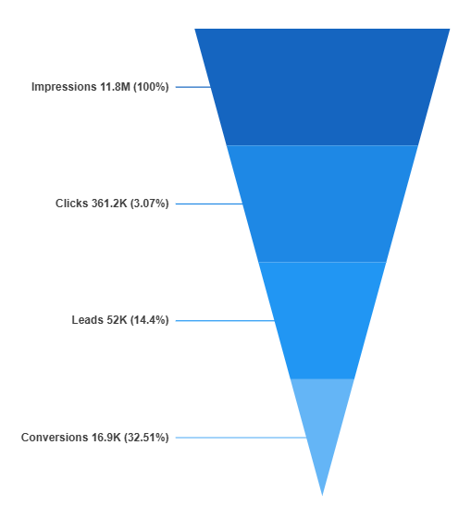
Campaign Funnel: From Impressions to Conversions
Insight
CTR (Clicks / Impressions) ≈ 3.07%, Out of everyone who sees the ad, only 3% click on it
CTR (Clicks / Impressions) ≈ 3.07%, Out of everyone who sees the ad, only 3% click on it
Lead Rate (Leads / Clicks) ≈ 14.4%, Out of those who click, only 14% become leads
Closing Rate (Conversions / Leads) ≈ 32.5%, Out of leads, about one-third convert
The most critical stage: Impressions, Clicks. CTR is still on the low side, meaning the main issue is in the ad appeal (headline, visuals, or targeting).

Slide 8

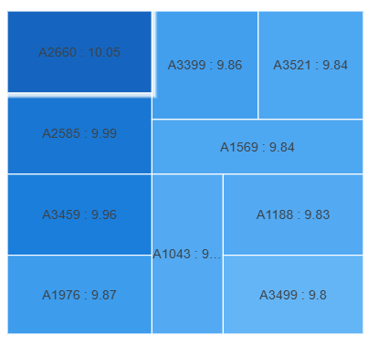
Top Ads by ROI
Insight
Ad A2660 has the highest ROI (10.05%), followed by A2585 (9.99%) and A3459 (9.96%)
ROI differences among the top 10 ads are very small (<0.3%)

Slide 9
Final insight and Recommendation
Final Insight
Based on analysis:
CR is already good, but CTR could be improved to unlock more conversions.
Mobile drives the highest CR.
ROI is spread evenly among the top 10 ads, meaning no single ad dominates.
The biggest weakness is in the first funnel stage (Impressions → Clicks), while the last stage (Leads → Conversions) performs strongly.

Slide 10
Final insight and Recommendation
Recommendation
Boost CTR
Test different headlines, visuals, and ad formats.
Refine audience targeting to reach more relevant users.
2. Optimize Click → Lead
Shorten the form.
Add trust elements (testimonials, guarantees, etc.).
Make sure the landing page matches the ad content.
3. Scale high-ROI ads
Allocate more budget to A2660, A2585, and A3459.

